Slide 1



Data Professional Survey
View in Power BI
Last data refresh:
12/4/2024 10:47:44 PM UTC
Downloaded at:
12/4/2024 10:53:26 PM UTC

Slide 2
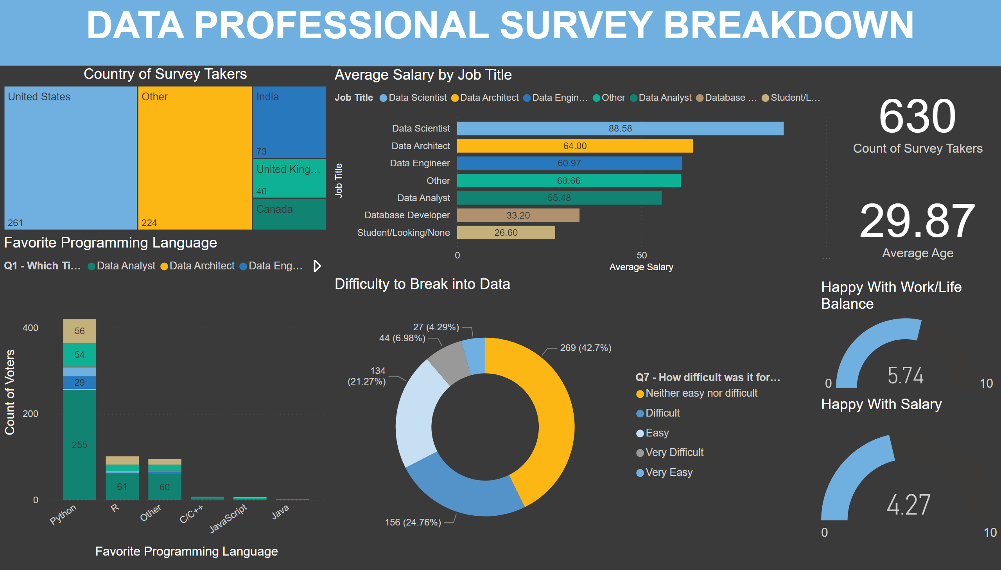
POWER BI Project
Notes:
textbox
No alt text provided
card
No alt text provided
card
No alt text provided
Average Salary by Job Title
No alt text provided
Favorite Programming Language
No alt text provided
Country of Survey Takers
No alt text provided
Happy With Salary
No alt text provided
Happy With Work/Life Balance
No alt text provided
Difficulty to Break into Data
No alt text provided

